Slide 1

9. Oracles
Mastering Ethereum - Building Smart Contracts and DApps, 2018
https://chain.link/education/blockchain-oracles

Slide 2
Introduction
Blockchain-based smart contracts and traditional data and API economies have immense potential to combine into hybrid smart contracts and form the future architecture of data-driven automation, but the question is how do these two worlds connect?
Bridging the connection between the blockchain (on-chain) and the outside world (off-chain) requires an additional and separate piece of infrastructure known as an oracle.
Oracles are systems that can provide external data sources to Ethereum smart contracts. Ideally oracles are systems that are trustless, meaning that they do not need to be trusted because they operate on decentralized principles.

Slide 3
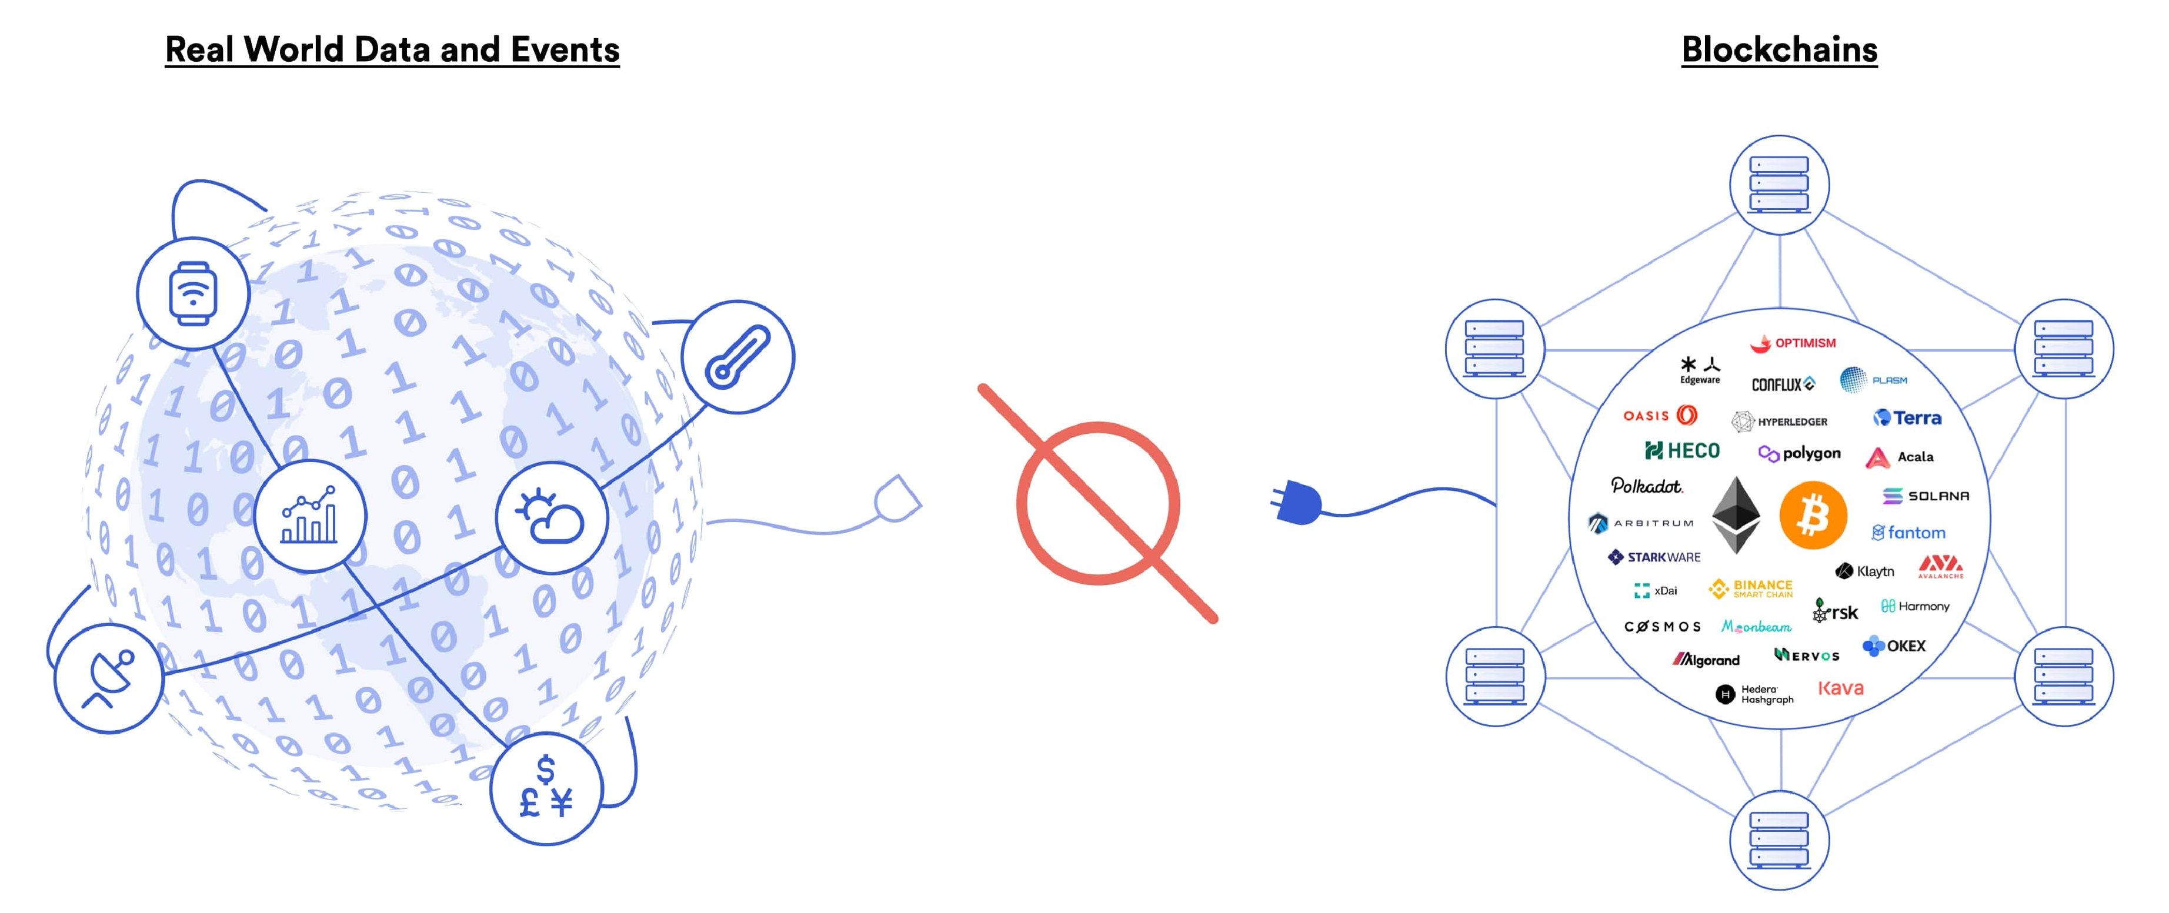
Blockchain Oracle Problem
(Chainlink)
Blockchains cannot connect to real-world data and events on their own

Slide 4
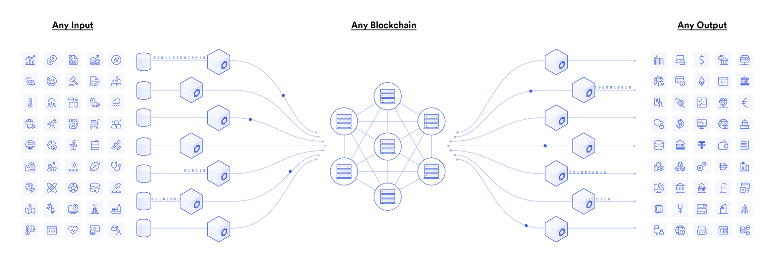
Using Oracles
(Chainlink)
Blockchain oracles connect blockchains to inputs and outputs in the real world

Slide 5
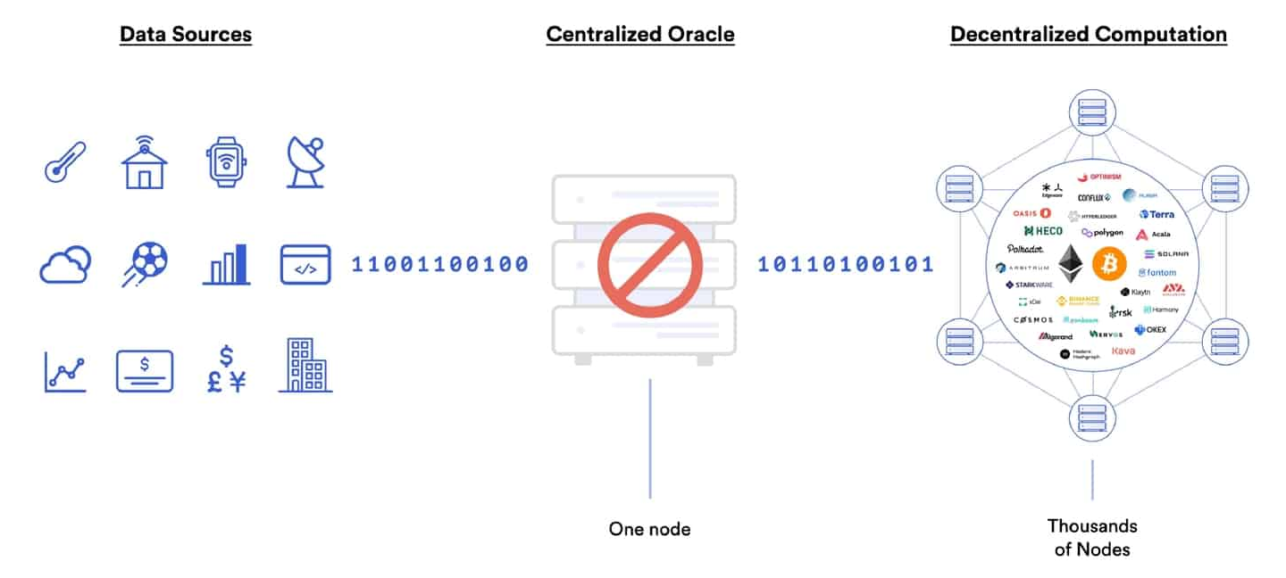
Centralized Oracles
(Chainlink)
Centralized Oracles are a Single Point of Failure

Slide 6
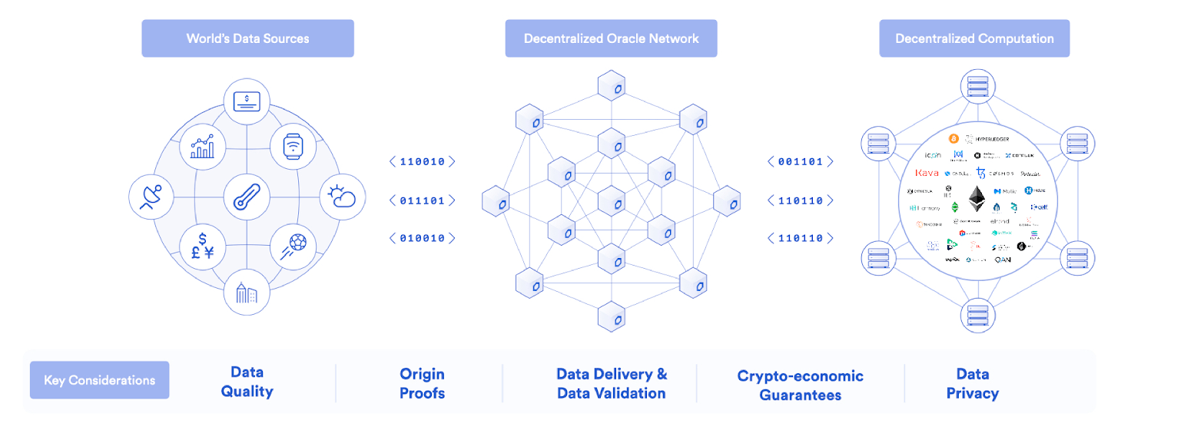
Decentralized Oracle Networks (DONs)
(Chainlink)
DONs allow smart contracts to securely connect with external data and systems.

Slide 7
Types of Blockchain Oracles (1/2)
Input Oracles
Fetch data from off-chain sources and deliver it to the blockchain network for smart contract consumption. E.g. Chainlink Price Feeds provide DeFi smart contracts with on-chain access to financial market data.
Output Oracles
Allow smart contracts to send commands to off-chain systems that trigger them to execute certain actions. E.g. informing a banking network to make a payment.

Slide 8
Types of Blockchain Oracles (2/2)
Cross-Chain Oracles
Enable interoperability for moving both data and assets between blockchains, such as using data on one blockchain to trigger an action on another or bridging assets cross-chain so they can be used outside the native blockchain they were issued on.
Compute-Enabled Oracles
Provide a very useful, secure, off-chain, computation solution to perform computations on a set of inputs; it is an alternative to the comparatively expensive computation cost on the Ethereum network.

Slide 9
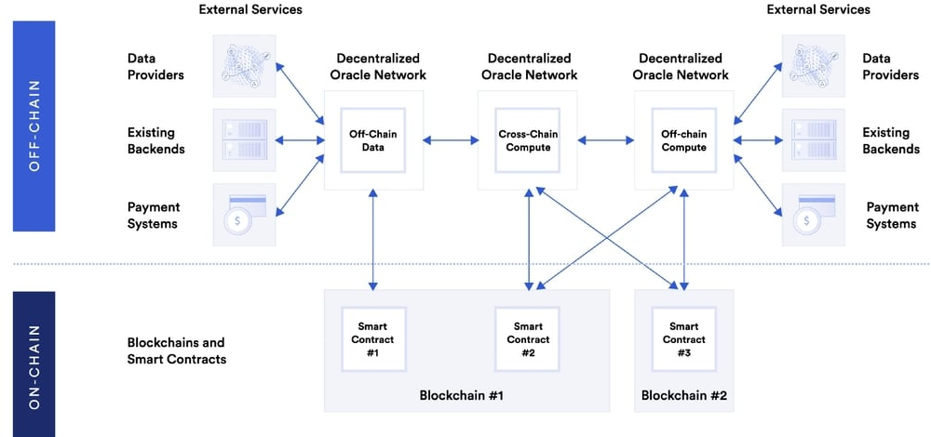
Hybrid Smart Contracts using Oracles
(Chainlink)

Slide 10
Oracle Design Patterns (1/2)
All oracles provide a few key functions, by definition. These include the ability to:
Collect data from an off-chain source.
Transfer the data on-chain with a signed message.
Make the data available by putting it in a smart contract’s storage.
Once the data is available in a smart contract’s storage, it can be accessed by other smart contracts via message calls that invoke a “retrieve” function of the oracle’s smart contract.
It can also be accessed by Ethereum nodes or network-enabled clients directly by “looking into” the oracle’s storage.

Slide 11
Oracle Design Patterns (2/2)
The three main ways to set up an oracle can be categorized as
Immediate-read: This type of oracle stores data once in its contract storage, whence any other smart contract can look it up using a request call to the oracle contract. It may be updated.
Publish-subscribe: This type of oracle effectively provides a broadcast service for data that is expected to change (perhaps both regularly and frequently), which is either polled by a smart contract on-chain, or watched by an off-chain daemon for updates.
Request–response: (Most complicated) This is where the data space is too huge to be stored in a smart contract and users are expected to only need a small part of the overall dataset at a time. Such an oracle might be implemented as a system of on-chain smart contracts and off-chain infrastructure used to monitor requests and retrieve and return data.

Slide 12
More on Request–response Oracles (1/2)
A request for data from a decentralized application would typically be an asynchronous process involving a number of steps:
1. EOA transacts with a decentralized application, resulting in an interaction with a function defined in the oracle smart contract. This function initiates the request to the oracle, with the associated arguments detailing the data requested in addition to supplementary information that might include callback functions and scheduling parameters.
2. Once this transaction has been validated, the oracle request can be observed as an EVM event emitted by the oracle contract, or as a state change; the arguments can be retrieved and used to perform the actual query of the off-chain data source. The oracle may also require payment for processing the request, gas payment for the callback, and permissions to access the requested data.

Slide 13
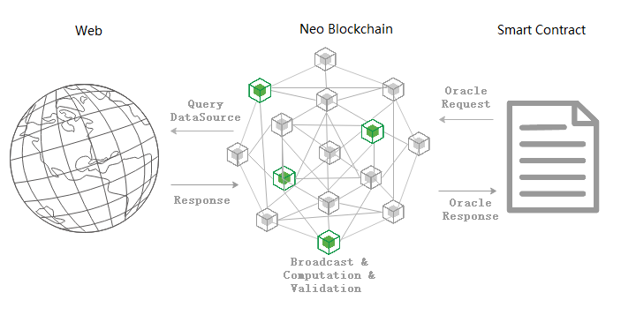
More on Request–response Oracles (2/2)
3. Finally, the resulting data is signed by the oracle owner, attesting to the validity of the data at a given time, and delivered in a transaction to the decentralized application that made the request — either directly or via the oracle contract.
Depending on the scheduling parameters, the oracle may broadcast further transactions updating the data at regular intervals (e.g., end-of-day pricing information).

Slide 14
Data Authentication (1/2)
Assume that the source of data being queried by a DApp is both authoritative and trustworthy (not insignificant assumption)
Given that the oracle and the request–response mechanism may be operated by distinct entities, how are we able trust this mechanism?
There is a distinct possibility that data may be tampered with in transit, so it is critical that off-chain methods are able to attest to the returned data’s integrity.
Two common approaches to data authentication are authenticity proofs and trusted execution environments (TEEs).

Slide 15
Data Authentication (2/2)
Authenticity proofs
Cryptographic guarantees that data has not been tampered with. Based on a variety of attestation techniques (e.g., digitally signed proofs), they effectively shift the trust from the data carrier to the attestor (i.e., the provider of the attestation).
By verifying the authenticity proof on-chain, smart contracts are able to verify the integrity of the data before operating upon it.
Oraclize (now Provable) is an example of an oracle service leveraging a variety of authenticity proofs.
TEE (Trusted Execution Environments) approach
Utilizing hardware-based secure enclaves to ensure data integrity.

Slide 16
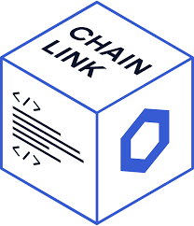

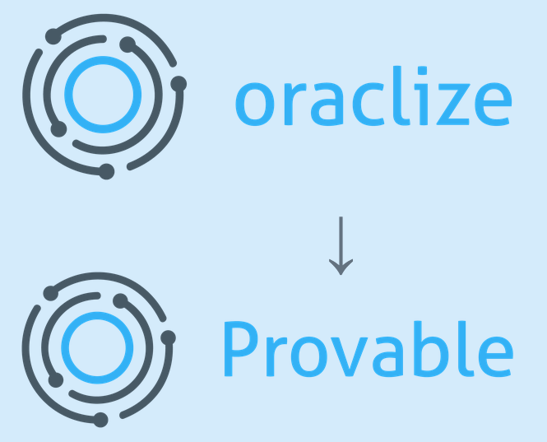


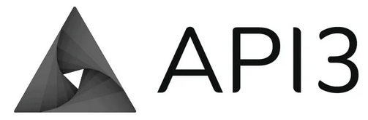
Top Decentralized Oracles
https://medium.com/stakin/the-top-decentralized-oracles-169b94dfbb83
Chainlink
Witnet
Provable (P.490 Example 11-1 and 11-2 using Oraclize)
The Band Protocol
Decentralized Information Asset (DIA)
API3

Slide 17
Introduction to Chainlink (1/3)
(Based on https://research.chain.link/whitepaper-v1.pdf)
https://www.gemini.com/cryptopedia/what-is-chainlink-and-how-does-it-work
Chainlink is a decentralized network of nodes that provide data and information from off-blockchain sources to on-blockchain smart contracts via oracles.
The process starts on a smart-contract-enabled blockchain when a smart contract requires data. That smart contract (Requesting Contract) puts out a request for information.
The Chainlink protocol registers this request as an ‘event’ and in turn creates a corresponding smart contract (Chainlink Service Level Agreement (SLA) Contract), also on the blockchain, to get this off-chain data.

Slide 18
Introduction to Chainlink (2/3)
The Chainlink SLA Contract generates three sub-contracts: a Chainlink Reputation Contract, a Chainlink Order-Matching Contract, and a Chainlink Aggregating Contract.
The Chainlink Reputation Contract checks an oracle provider’s track record to verify its authenticity and performance history — then evaluates and discards disreputable or unreliable nodes.
The Chainlink Order-Matching Contract delivers the Requesting Contract’s request to Chainlink nodes and takes their bids on the request (when the Requesting Contract does not choose a specific set of nodes) — and then selects the right number and type of nodes to fulfill the request.
The Chainlink Aggregating Contract takes all the data from the chosen oracles and validates and/or reconciles it for an accurate result.

Slide 19
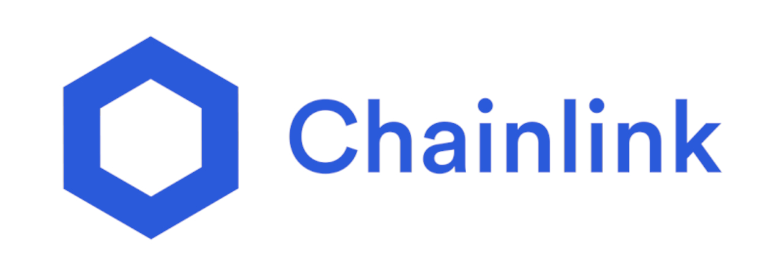
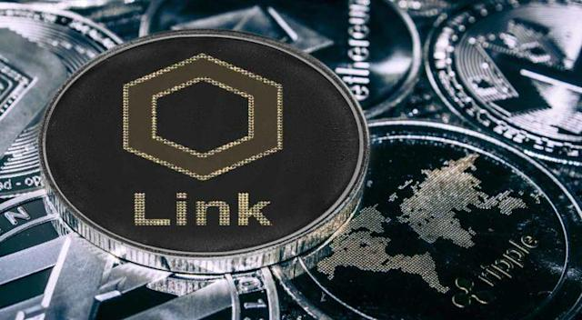
Introduction to Chainlink (3/3)
Requesting Contract holders use LINK to pay Chainlink node operators for their work. Prices are set by the Chainlink node operator based on demand for the data they can provide and the current market for that data.
LINK is built on Ethereum in accordance with the ERC-20 standard for tokens. It can be bought and sold for fiat currency or other digital currencies.

Slide 20
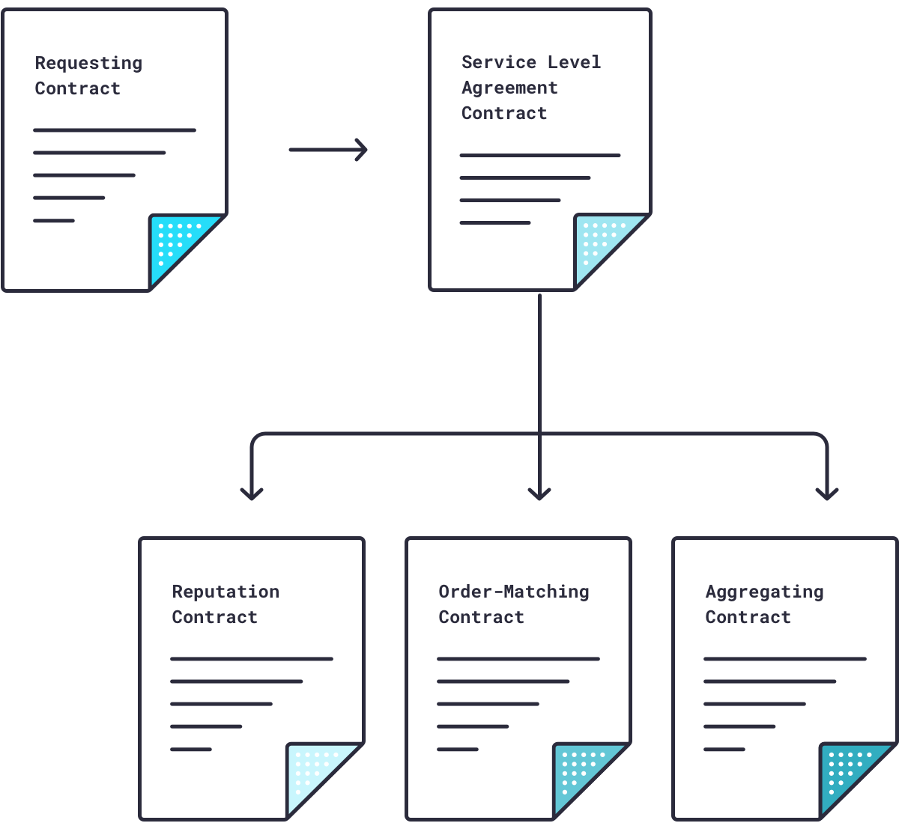
Chainlink SLA Contract & Sub-Contracts (1/2)

Slide 21
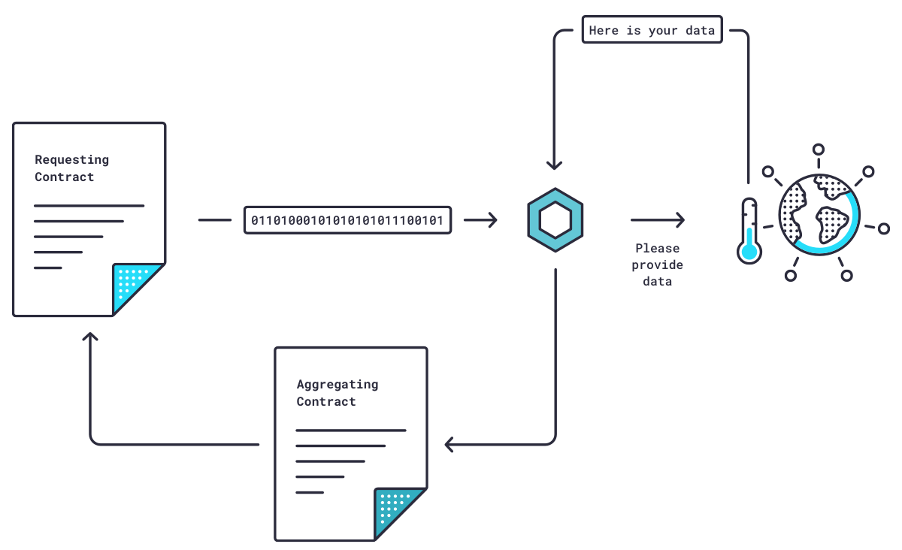
Chainlink SLA Contract & Sub-Contracts (2/2)

Slide 22
How Chainlink Nodes Reliably Validate Data (1/2)
The Chainlink Aggregating Contract can validate data from a single source and from multiple sources — and it can reconcile data from multiple sources.
So, if five nodes deliver one answer from a weather sensor and two other nodes deliver a different answer, the Chainlink Aggregating Contract will know that those two nodes are faulty (or dishonest) and discard their answers. In this manner, Chainlink nodes can validate data from a single source.

Slide 23
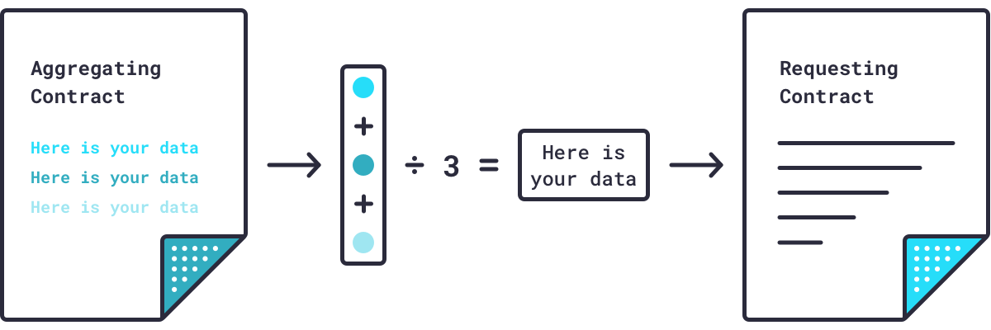
How Chainlink Nodes Reliably Validate Data (2/2)
The Chainlink Aggregating Contract can repeat this validation process for multiple sources, then reconcile all validated data by averaging it into a single piece of data.

Slide 24
What is a Chainlink Node Operator? (1/3)
https://blog.chain.link/what-is-a-chainlink-node-operator/
Chainlink node operators are entities running the oracle infrastructure (hardware/software) that powers and secures every oracle network running on the Chainlink Network.
These oracle node operators are responsible for watching the blockchain for new incoming data requests from smart contracts, fetching the requested off-chain data from specified APIs, and delivering the data on-chain where it can be consumed by a smart contract to trigger its execution.
While contracts can choose to send their data requests directly to a single Chainlink node and receive a single response back, Chainlink nodes are most powerful when combined together into an oracle network.

Slide 25
What is a Chainlink Node Operator? (2/3)
Decentralized oracle networks aggregate data from any number of Chainlink nodes to remove any single point of failure in the sourcing and delivery of that data to the blockchain.
The Chainlink Network is an infinitely scalable network of independent oracles and oracle networks. Although each oracle runs the Core Chainlink software, they ultimately operate without any dependencies from any other oracle, freely able to simultaneously be a part of different oracle networks and/or operate independently.
The Chainlink Network is permissionless to run an oracle on, but each oracle network can restrict the individual oracles allowed to contribute, as well as customize how data is sourced and aggregated within it.
Unlike a blockchain, there is no unified consensus mechanism or node network.

Slide 26
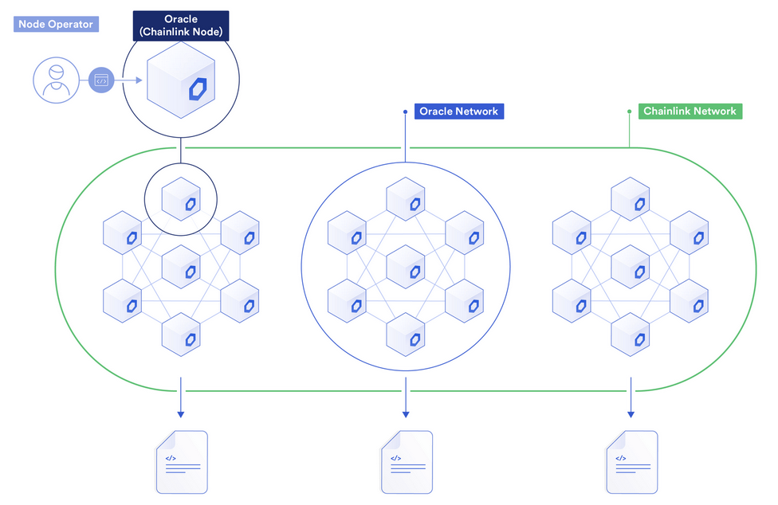
What is a Chainlink Node Operator? (3/3)

Slide 27
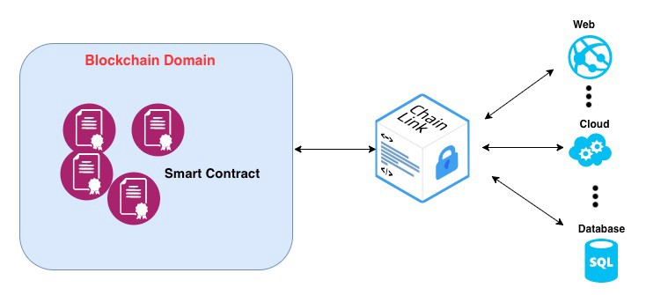
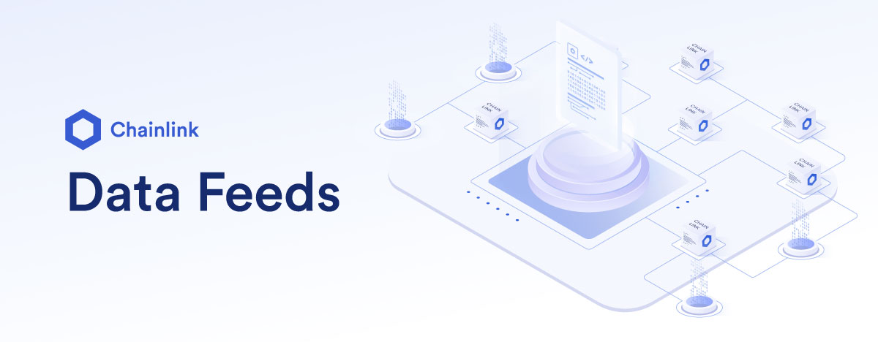
Homework-5: Using Chainlink Oracles
Using Remix & Kovan Testnet (Sepolia)
1. Using Chainlink Data Feeds
Ref. https://docs.chain.link/docs/consuming-data-feeds/
2. Using Chainlink API Calls
Ref. https://docs.chain.link/docs/advanced-tutorial/

Slide 28
Ref. Smart Contract Use Cases Enabled by Chainlink
https://blog.chain.link/44-ways-to-enhance-your-smart-contract-with-chainlink/
Decentralized Finance
External Payments
NFTs, Gaming, and Randomness
Insurance
Enterprise Systems
Supply Chain
Utilities
Authorization and Identity
Government
Sustainability
Off-Chain Computation

